Slide 1
Automatic Essay Grading
By Space Explorers
Sahil Chelaramani – 20162051
Pranav Dhakras – 20162303
Josyula Gopalkrishan – 20162137

Slide 2
Problem statement
Given an essay, our aim is to evaluate it and give a qualitative score.
While scoring an essay our aim is to consider multiple attributes of the essay to grade it.

Slide 3
Background
Essays can help assess the creative writing ability on the parameters such as ability to recall, organise, style of writing, and creativity.
The subjective nature of essay assessment leads to variation in grades awarded by human assessors, which is perceived by students as a source of unfairness.
A system for automated assessment should be consistent in the way it scores essays.
In addition enormous cost and time savings could be achieved if the system can be shown to grade essays within the range of those awarded by human assessors.

Slide 4
Challenges
While grading an essay the key points to look at are:
Grammatical correctness
Content of the essay
Organization of essay
Style of writing
Creativity (for especially for narrative essay)

Slide 5
Challenges
Evaluation biases
Plagiarism check
Students should not be able to cheat the system

Slide 6
Features
Sentiment
Unique N-grams
Long Word Count
Noun Count
Verb Count
Adjective Count
Spelling Error Count
Foreign Word Count
Essay length
Adverb Count
Sentence Count

Slide 7
Tools
Python
NLTK
Scikit Learn
PyEnchant
Vader
Tensor Flow

Slide 8
Techniques
Recursive feature elimination with cross-validation
Random Forest for regression
SVR from SciKit Learn
LSTM from Tensor Flow
AdaBoost from SciKit Learn

Slide 9
Feature selection/elimination
No. of training data samples: 500
5-fold cross-validation

Slide 10
Feature selection intuition
No. of nouns and verbs do not necessarily mean better writing style
Use of adjectives and adverbs is a better guess
Long sentences may make the essay too verbose to read
Foreign words may not be necessary for good essay

Slide 11
Feature selection/elimination
Adjective count
Adverb count
Long word count
Unique N-grams
Sentence count
Positive sentiment
Negative sentiment
Neutral sentiment

Slide 12
Intermediate results – Before feature selection
SVR was used for testing
13 extracted features were used
No. of training samples : 2434
No. of test samples : 806
Average Quadratic Kappa : 0.700992555831

Slide 13
Intermediate results
Only the selected features were used
SVR was used for testing
No. of training samples : 2434
No. of test samples : 806
Average Quadratic Kappa : 0.774193548387

Slide 14
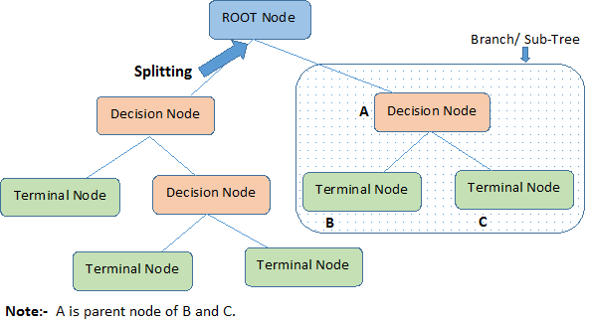
Decision Trees

Slide 15
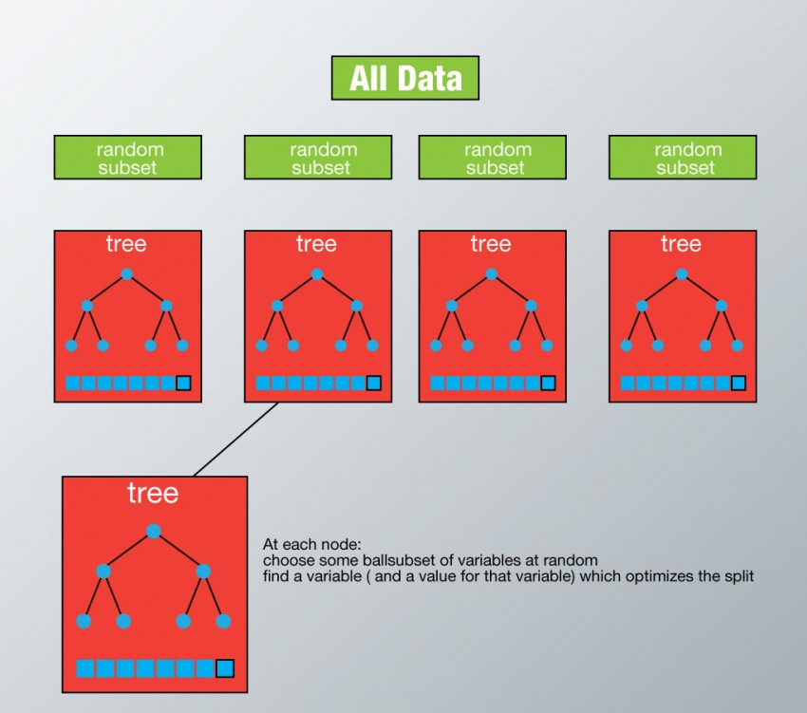
Random Forest

Slide 16
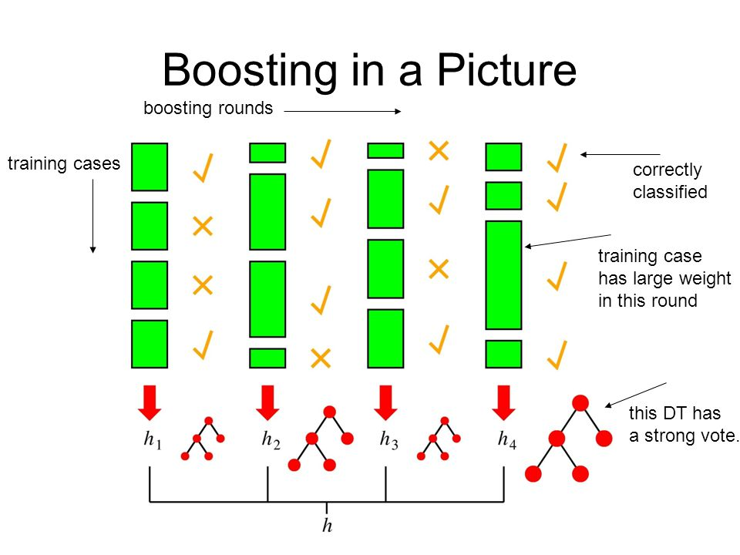

Slide 17

LSTM

Slide 18
Results – Selected features and GloVe
LSTM gave best performance
AdaBoost with Decision trees
Random forest implementation
SVR
Kappa ~ 0.90
Kappa ~ 0.82
Kappa ~ 0.80
Kappa ~ 0.76

Slide 19
Future work…

Slide 20
More features?
Limitations
Extracted feature are too shallow
Content of essay is factored only by GloVe
Creativity is underrated
Possible solutions?
Structure of sentences (using say TextRank)
Grammatical correctness
Combining GloVe and our feature set

Slide 21
Tweaking models
LSTM was most promising
Tweak LSTM parameters to suit improved feature set
Test other models with improved feature set

Slide 22
References
http://www.cs.cmu.edu/~norii/pub/aes.pdf
http://cs229.stanford.edu/proj2012/MahanaJohnsApte-AutomatedEssayGradingUsingMachineLearning.pdf
https://www.ets.org/Media/Research/pdf/RR-04-45.pdf
https://www.kaggle.com/c/asap-aes/details/background
https://www.analyticsvidhya.com/blog/2016/04/complete-tutorial-tree-based-modeling-scratch-in-python/#one
http://colah.github.io/posts/2015-08-Understanding-LSTMs/
Pennington, Jeffrey, Richard Socher, and Christopher D. Manning. ”Glove: Global Vectors for Word Representation.”

Slide 23
Q & A

